Slide 1




XChemExplorer
Updates
10/07/2020
Tobias Krojer

Slide 2
Agenda
Under the hood
Data collection
Initial refinement
Model building & refinement
PanDDA group deposition
Outlook

Slide 3
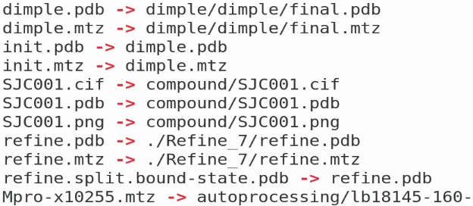
Design philosophy
XCE records a plethora of information in a SQLite DB
But most relevant information is contained in the file system
Manual changes to the files can be made at any time
Modified models can be brought back into XCE if filenames adhere to convention
Original files are stored in subfolders in sample folder
Symlinks with reserved file names point to original files:
e.g. sample folder Mpro-x10255
…
…

Slide 4
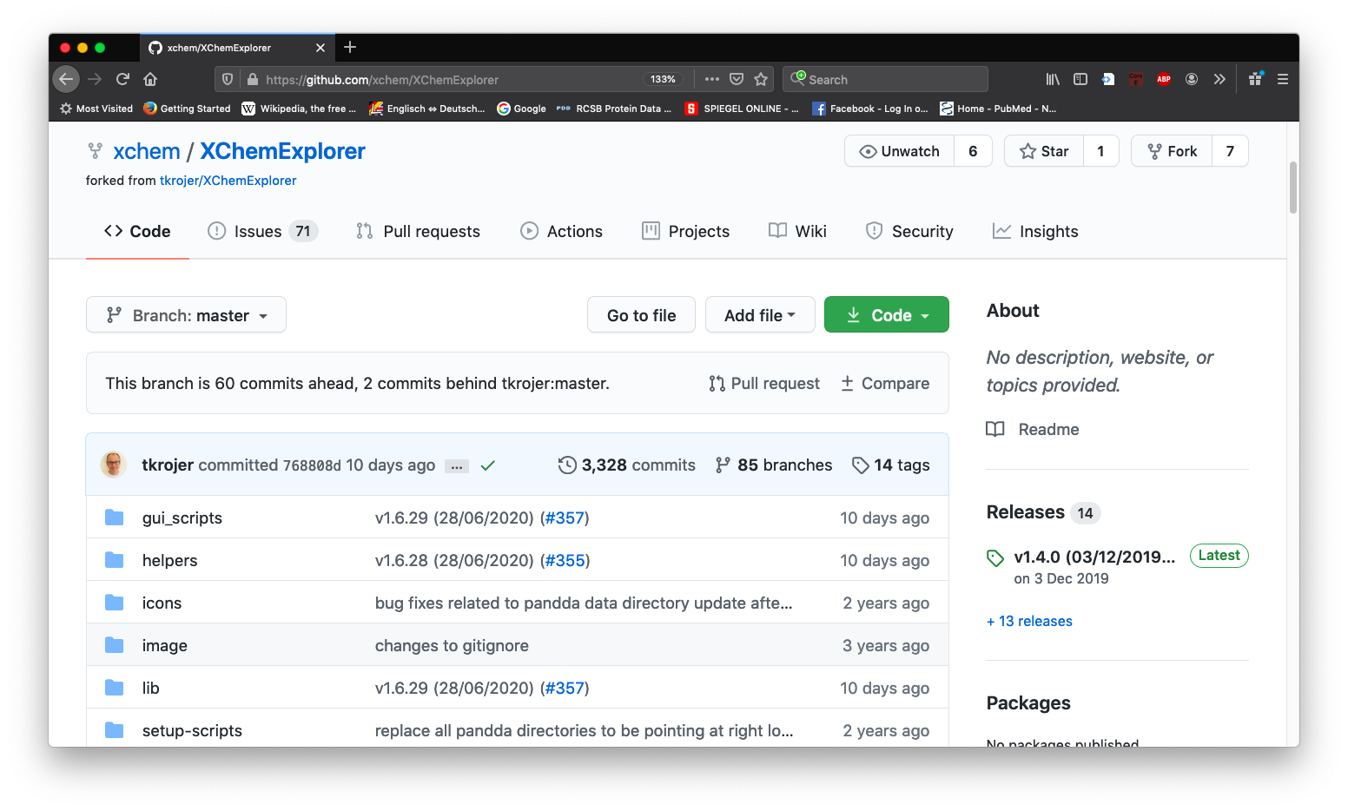
Where does XCE life?
https://github.com/xchem/XChemExplorer
download

Slide 5
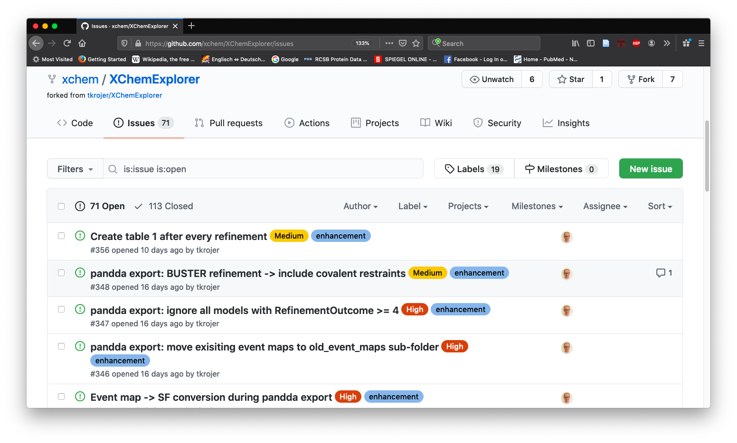
XCE: issues
Feel free to add issues if necessary (just need to register with Github)

Slide 6
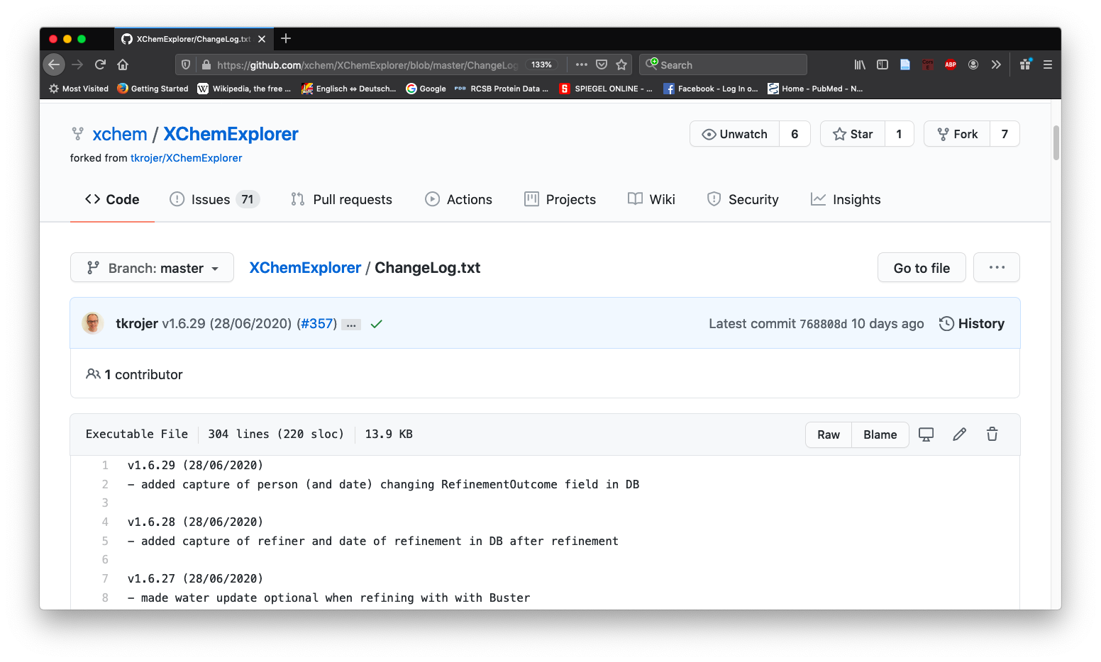
XCE: ChangeLog.txt

Slide 7
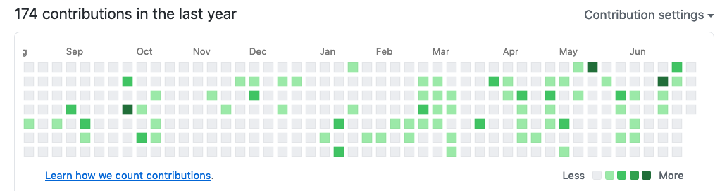
Moreover…
Semantic versioning:
MAJOR.MINOR.PATCH, e.g. v1.6.29
MAJOR version when you make incompatible API changes,
MINOR version when you add functionality in a backwards compatible manner
PATCH version when you make backwards compatible bug fixes.
frequent updates as far as possible
86 new new versions since 12/02/2019
1.7.0 only works with CCP4 v7.1 (or higher)
Gemmi (Marcin Wojdyr’s amazing python library)

Slide 8
Under the hood
Questions?

Slide 9
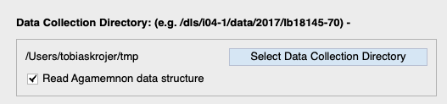
Automated data Collection at DLS
Setting tab
Past:
1 puck = 1 visit
top-level directory: Agamemnon
Present:
all pucks in one visit
top-level directory: auto
Future:
???

Slide 10
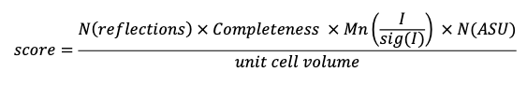
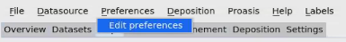
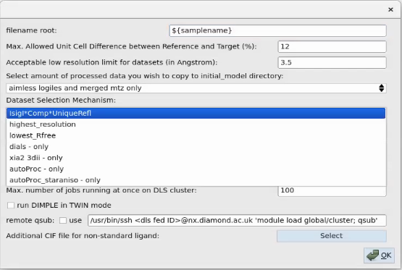
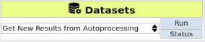
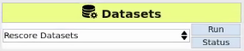
Dataset selection
Default selection mechanism
Before parsing
After parsing

Slide 11
Data Collection
Questions?

Slide 12
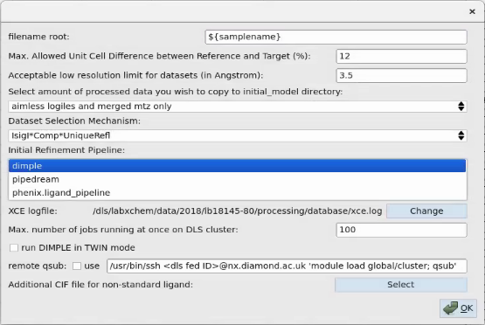
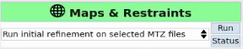
Initial refinement
Additional automated refinement pipelines
Note: Phenix & Pipedream take muuuuuch longer than Dimple!!!

Slide 13
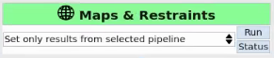
Initial refinement
Additional automated refinement pipelines
Different subfolders for each pipeline:
dimple
phenix.ligand_pipeline
pipedream
Final PDB/ MTZ files are linked in sample directory as
dimple.pdb / dimple.mtz
phenix.ligand_pipeline.pdb / phenix.ligand_pipeline.mtz
pipedream.pdb / pipedream.mtz
Currently selected pipeline is linked as init.pdb init.mtz, e.g.
(Note: only relevant if you want to look at maps/ models in XCE COOT interface)
→ select pipeline in preferences, then run:

Slide 14
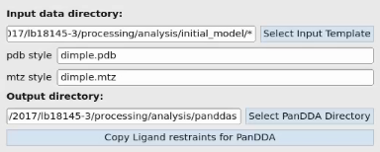
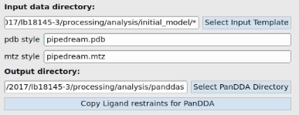
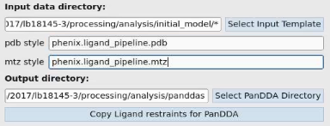
Initial refinement
Additional automated refinement pipelines
PanDDA tab
DIMPLE
If you want to run PanDDA with maps from a different refinement program, change
pdb_style
mtz_style
in the PanDDA tab before running pandda.analyse
pipedream
phenix.ligand_pipeline

Slide 15
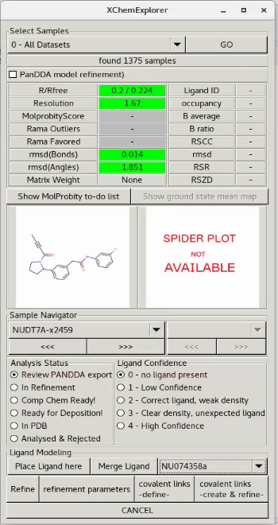
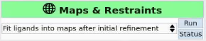
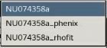
Initial refinement
Automated ligand fitting in 2fofc maps
Runs (if available):
rhofit
phenix.ligandfit
Note: only works in non-PanDDA mode
(“PanDDA model refinement” must be unchecked)
XCE COOT interface:
Select ligand from dropdown
Improve fit (if necessary)
Merge Ligand
Refine

Slide 16
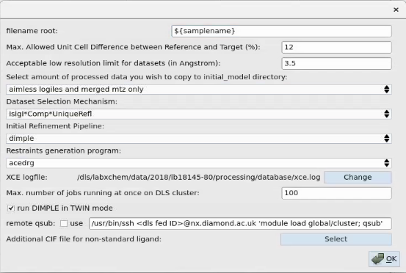
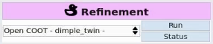
Initial refinement
Twinned initial refinement (DIMPLE)
dimple_twin.pdb
dimple_twin.mtz
Note:
Twinned data can be refined in XCE COOT
See “Refinement Parameters”

Slide 17
Initial Refinement
Questions?

Slide 18
XCE: routes from MTZ to PDB
Dimple (REFMAC)
REFMAC
PanDDA
export
giant.quick_refine (REFMAC)

Slide 19
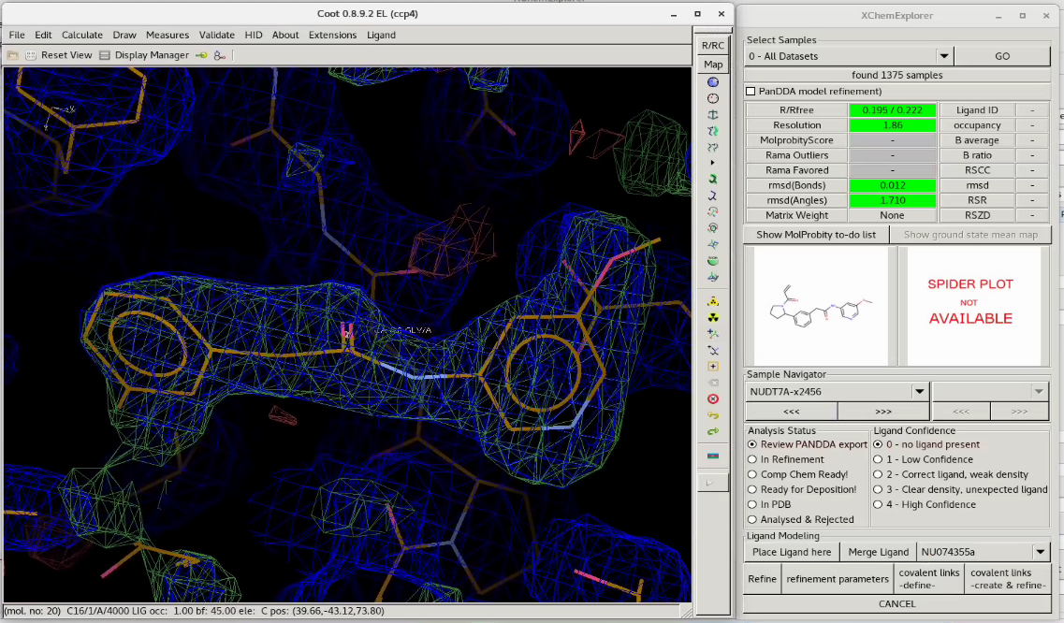
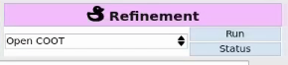
Standard refinement
Untick ’PanDDA model refinement’
1. Place ligand here
2. Merge Ligand
3. Refine
XCE looks for the following files in the following order:
refine.pdb/ refine.mtz
init.pdb/ init.mtz
dimple.pdb/ dimple.mtz

Slide 20
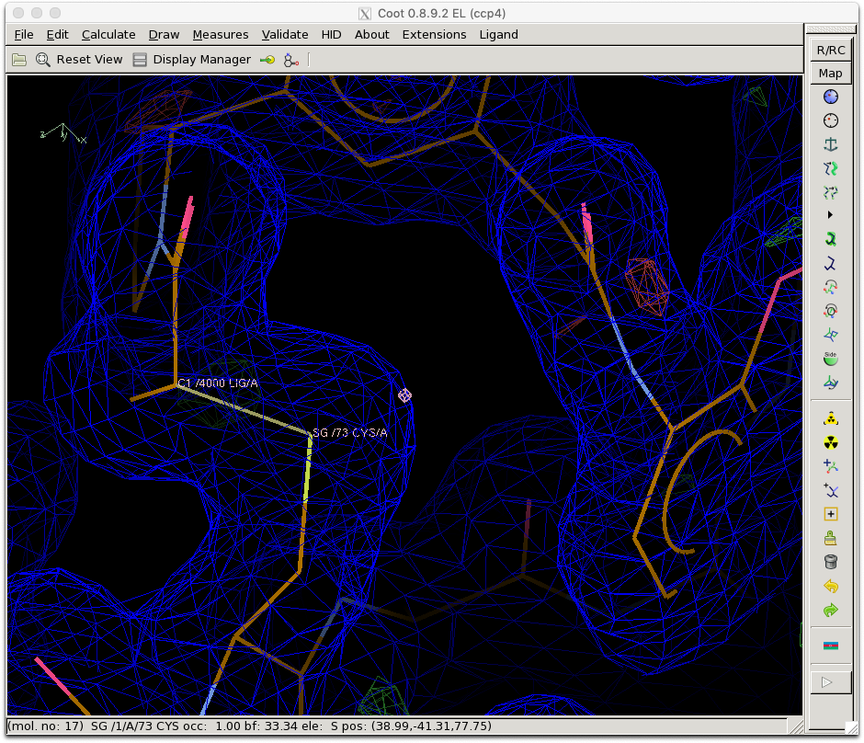
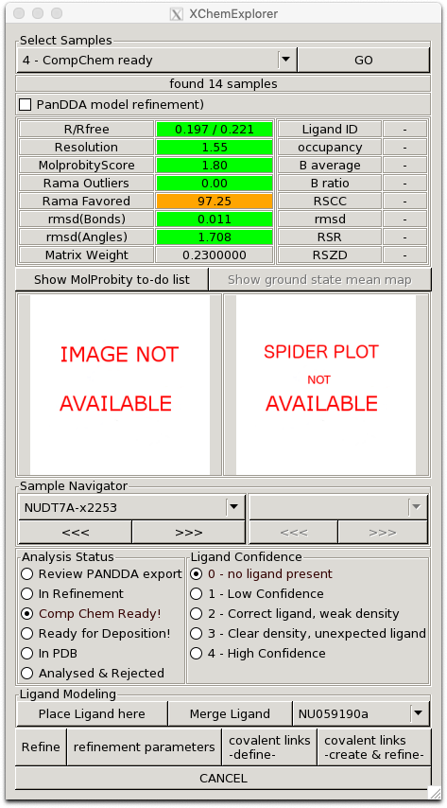
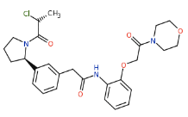
XCE: interactive modeling of covalent binders
2. Click atoms
1. Define covalent links
3. Create & refine
Limitation: does not work in case bond order changes
Process:
Convert original ligand CIF with ACEDRG (daft, but necessary due to nomenclature issues)
Generate LINK parameters with ACEDRG
Refine

Slide 21
Refinement of PanDDA models
Strategy 1: export & giant.quick_refine
PanDDA directory
ground-state.pdb
Project directory
pandda.inspect
pandda.export
ensemble.pdb
giant.quick_refine
(REFMAC)
bound-state.pdb
ground-state.pdb
bound-state.pdb
All modelling must be done in pandda.inspect, refinement is only for weight adjustment and review
COOT

Slide 22
Refinement of PanDDA models
Strategy 1: export & giant.quick_refine

Slide 23
Model building & refinement
Questions?

Slide 24
PanDDA group depositions
Many structures to deposit (10s per fragment campaign)
Automated mmCIF file generation in XChemExplorer for
PDB group deposition system

Slide 25
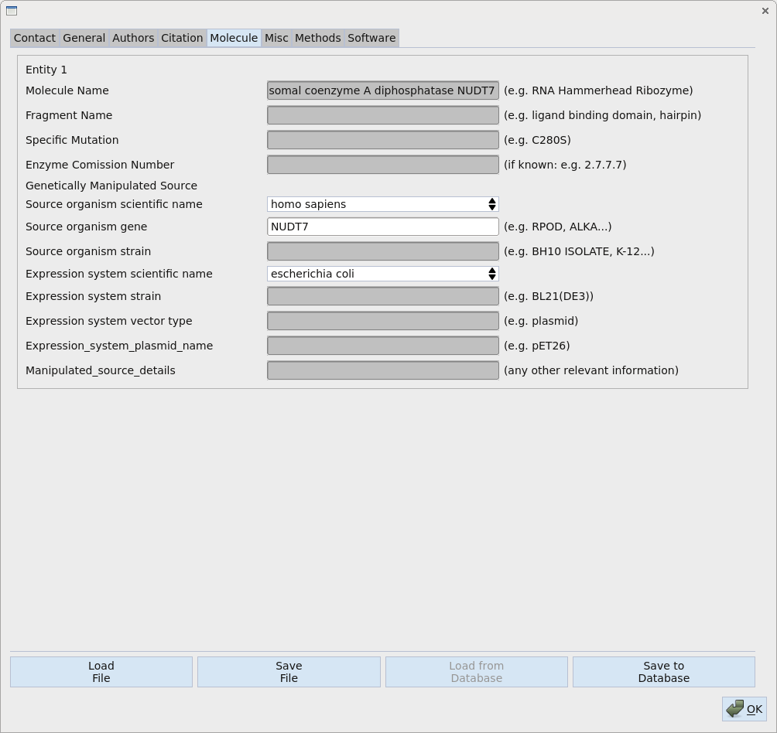
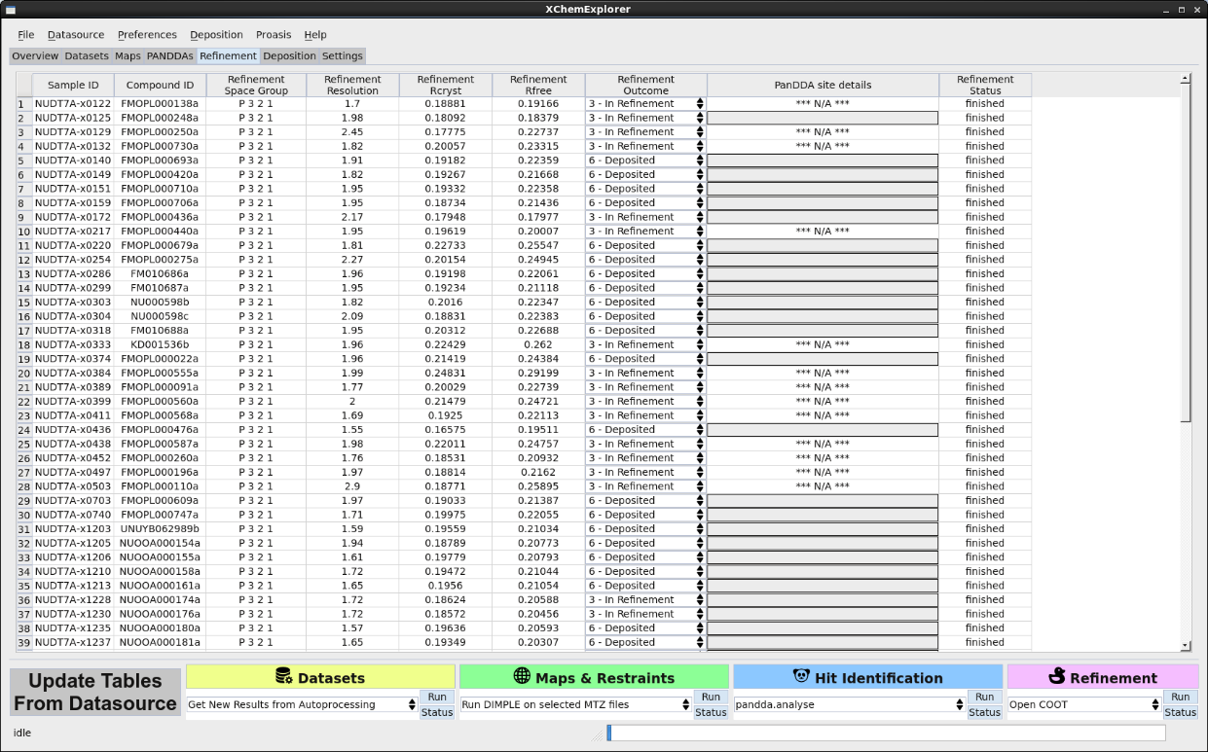
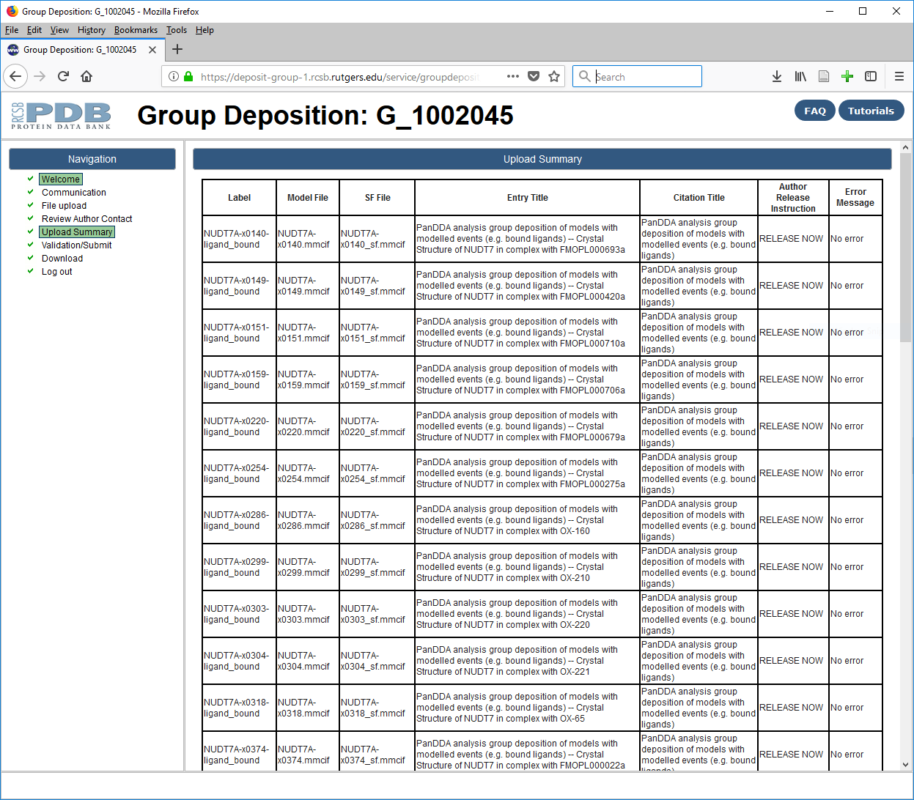
PDB group deposition
Beamline,
Date,
etc.
Authors,
Title,
Sequence,
Expression system,
etc.
PDB
MTZ
LOG
XCE deposition preparation
XChemExplorer
pdb_extract
Sf_convert
bound-state.tar.bz2
ground-state.bar.bz2
http://tkrojer.github.io/XChemExplorer
PDB group deposition system

Slide 26
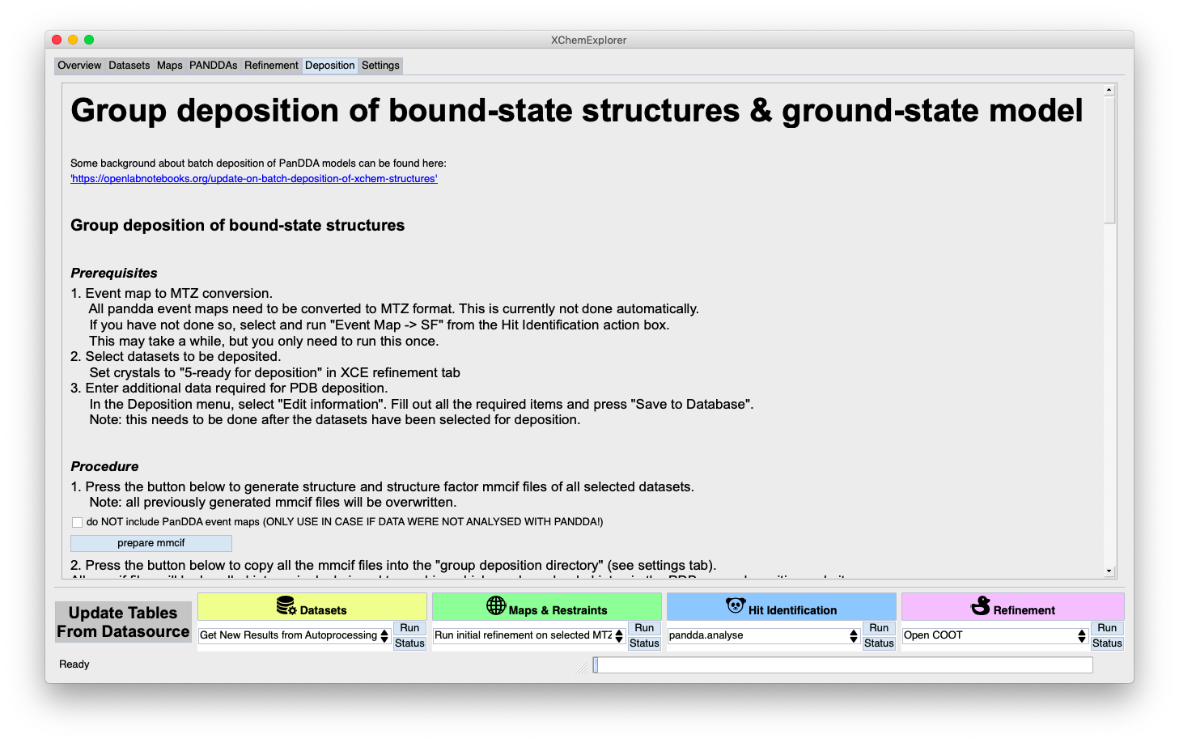
XCE: step-by-step instructions

Slide 27
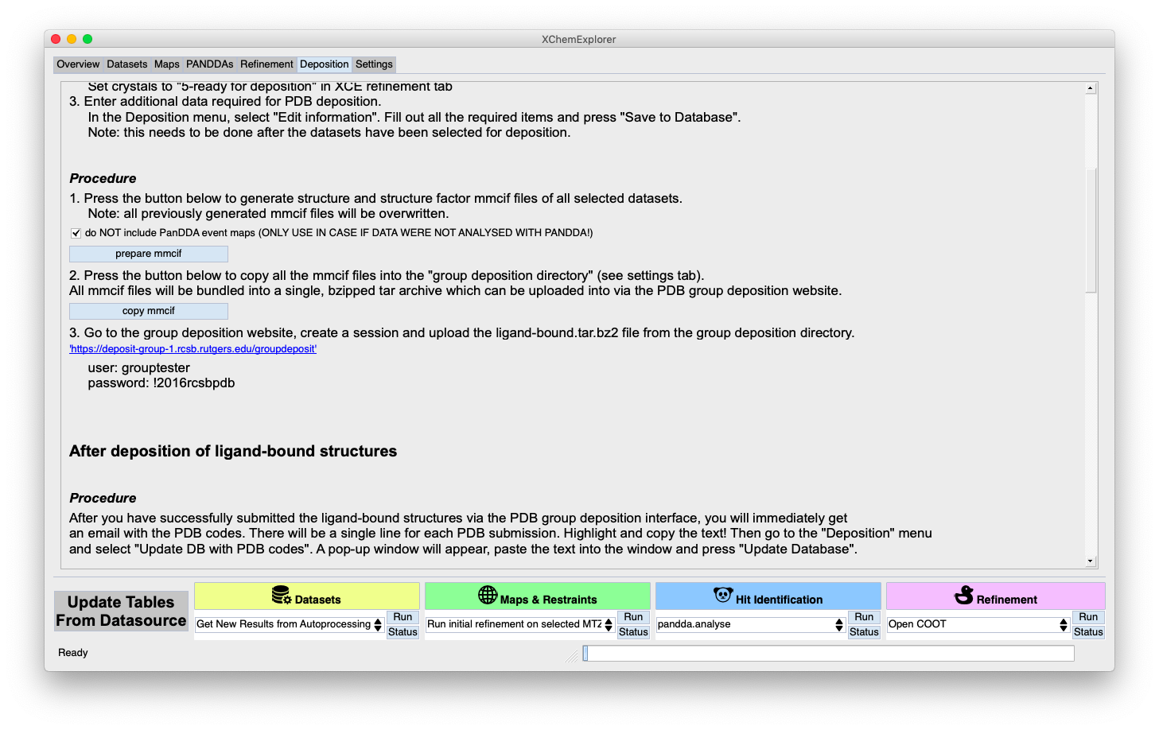
non-PanDDA group depositions
check: do NOT include PanDDA event maps

Slide 28
PanDDA group depositions
Many structures to deposit (10s per fragment campaign)
Automated mmCIF file generation in XChemExplorer for
PDB group deposition system
Modelled ligands sometimes weak in 2fofc maps,
i.e. evidence for ligand not obvious
Inclusion of PanDDA event map in deposited SF mmCIF

Slide 29
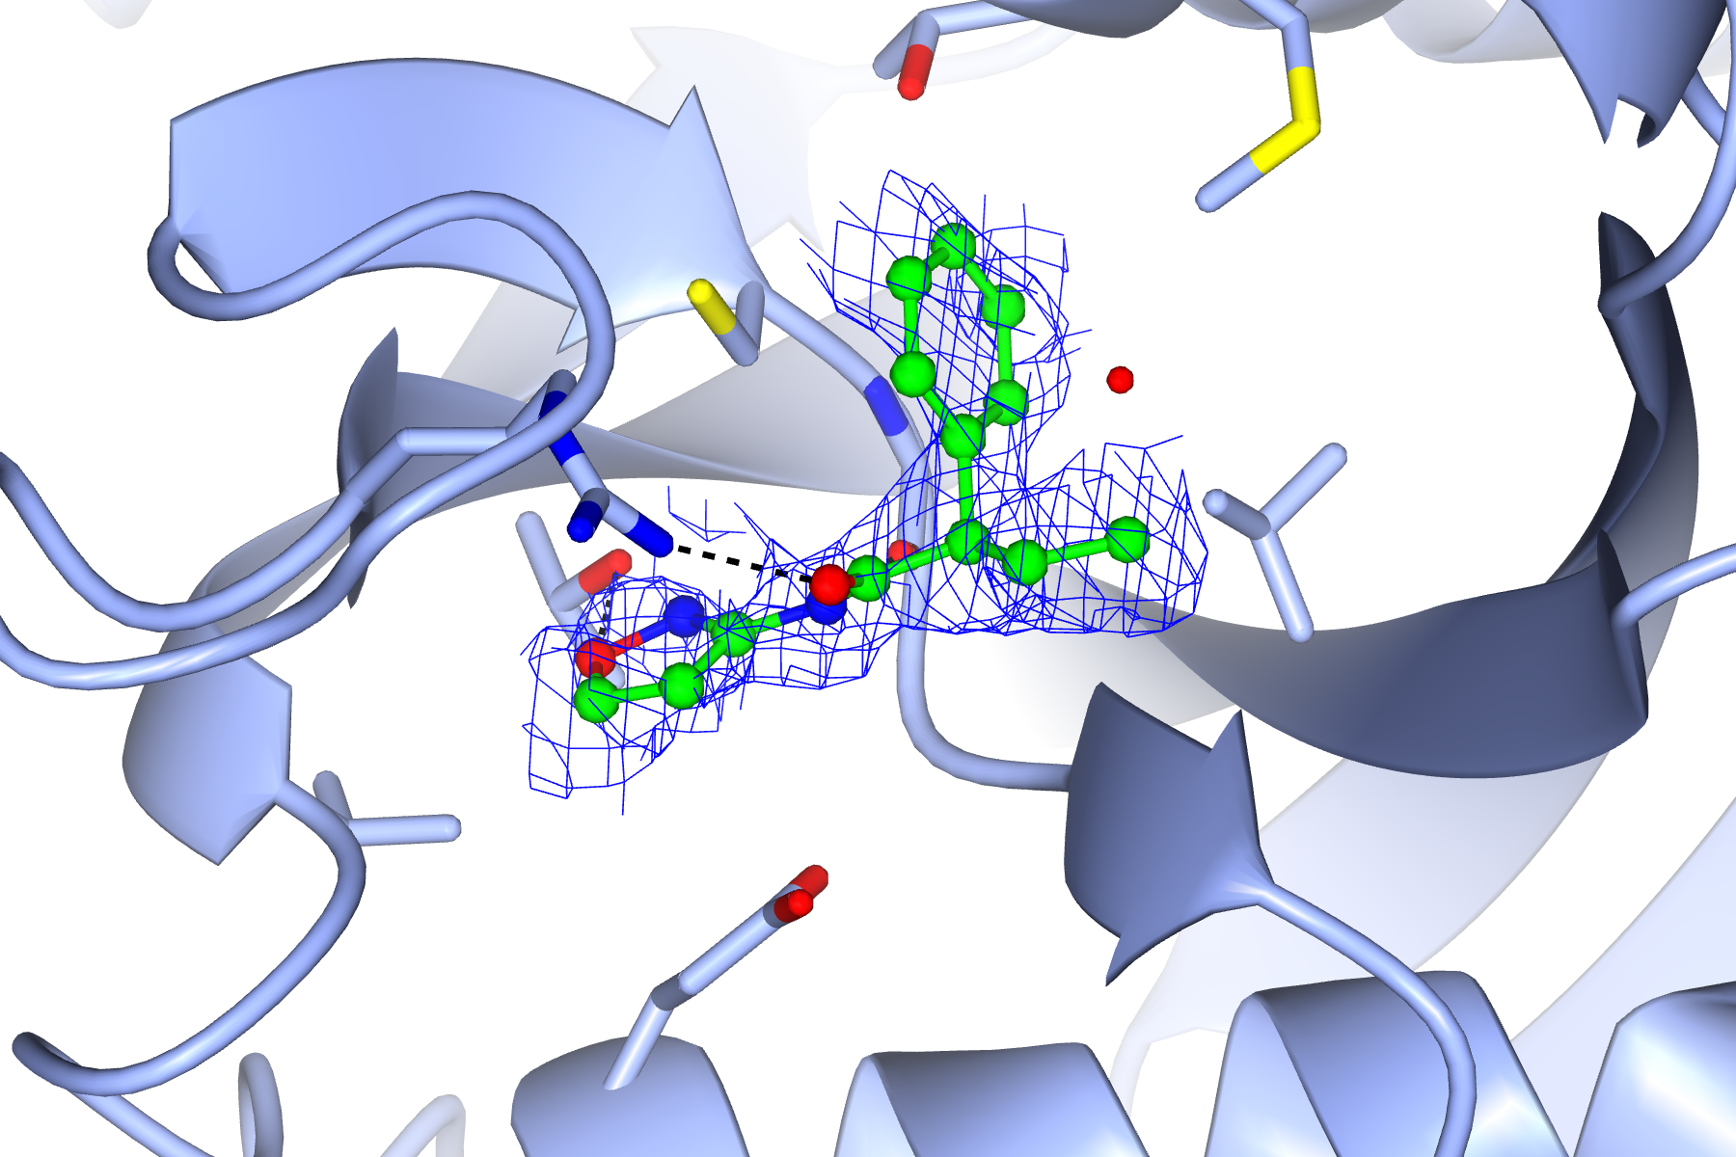
Inclusion of PanDDA event map in PDB deposition
2fofc map

Slide 30
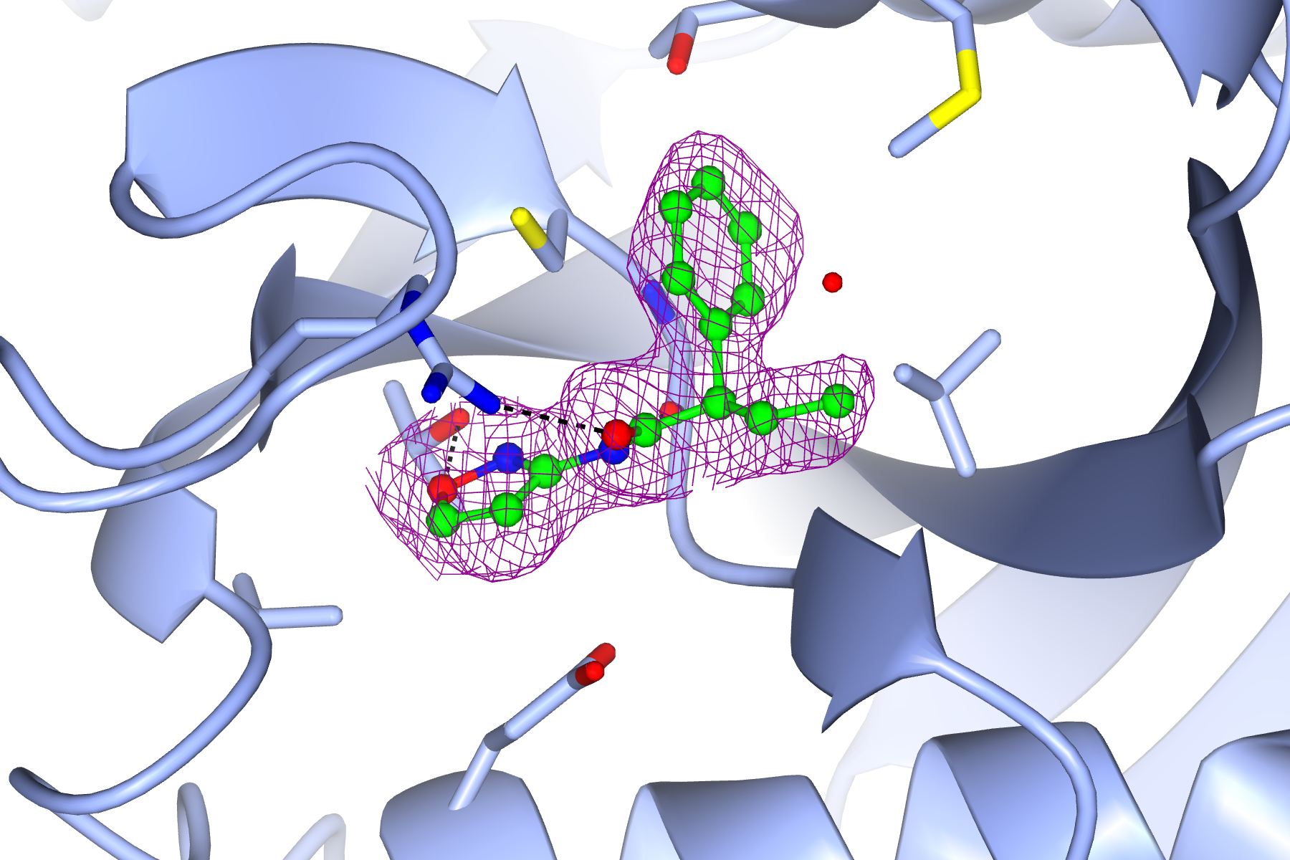
Inclusion of PanDDA event map in PDB deposition
PanDDA event map
_diffrn.details "data for ligand evidence map (PanDDA event map), event_map1.mtz"

Slide 31
PanDDA PDB group deposition
PDB ID 1
PDB ID 2
PDB ID 3
PDB ID 4
bound_state.pdb
F_{obs}, SIGF_{obs}
F_{event_<n>}, PHI_{event_<n>}
Ligand-bound structures
PDB group ID

Slide 32
PanDDA group depositions
Many structures to deposit (10s per fragment campaign)
Automated mmCIF file generation in XChemExplorer for
PDB group deposition system
Modelled ligands sometimes weak in 2fofc maps,
i.e. evidence for ligand not obvious
Inclusion of PanDDA event map in deposited SF mmCIF
Reproducibility of results
Deposition of all apo structures

Slide 33
PanDDA PDB group deposition
ground_state.pdb
F_{mean_map}, PHI_{mean_map}
F_{d001}, SIGF_{d001}
F_{d002}, SIGF_{d002}
…
F_{d<n>}, SIGF_{d<n>}
PDB ID 1
PDB ID 2
PDB ID 3
PDB ID 4
bound_state.pdb
F_{obs}, SIGF_{obs}
F_{event_<n>}, PHI_{event_<n>}
PDB ID 5
Ligand-bound structures
Apo structure
(ground state)
Complete
PanDDA
analysis
PDB group ID (bound-state)
PDB group ID (ground-state)
_pdbx_related_exp_data_set.ordinal _pdbx_related_exp_data_set.data_reference _pdbx_related_exp_data_set.metadata_reference _pdbx_related_exp_data_set.data_set_type _pdbx_related_exp_data_set.details

Slide 34
PanDDA group depositions
Recent Sars-Cov-2 M^{pro} PDB depositions
Community feedback:
What is the evidence for the modelled ligand? The 2fofc maps do not at all support its presence!
R/Rfree values are too high!
How can we reproduce your calculations?
Your models are dodgy, because several protein residues have occupancies smaller than one!
Ligand restraints seems wrong

Slide 35
PanDDA group depositions
thoughts and observations…
Depositing the bound-state model is community standard
But our approach of refining an ensemble model, but depositing the bound-state caused confusion
Technically, ground-state and bound-state depositions are interrelated and belong together as one multi-datasets experiment
In practice, we have not communicated this concept enough and it is probably too complicated
Scientifically though, only bound-state is relevant and non-crystallographers tend not be interested in this discussion
Nevertheless, bound-state was clearly dominant in the vast majority of our models
So why not refine bound-state only as one would usually do and reserve ensemble refinement (ensemble deposition) for cases where bound-state/ ground-state differ significantly?

Slide 36
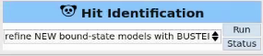
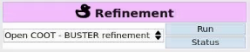
Refinement of PanDDA models
Strategy 2: BUSTER
ground-state.pdb
pandda.inspect
bound-state.pdb
BUSTER
bound-state.pdb
COOT
You can manipulate model as you want

Slide 37
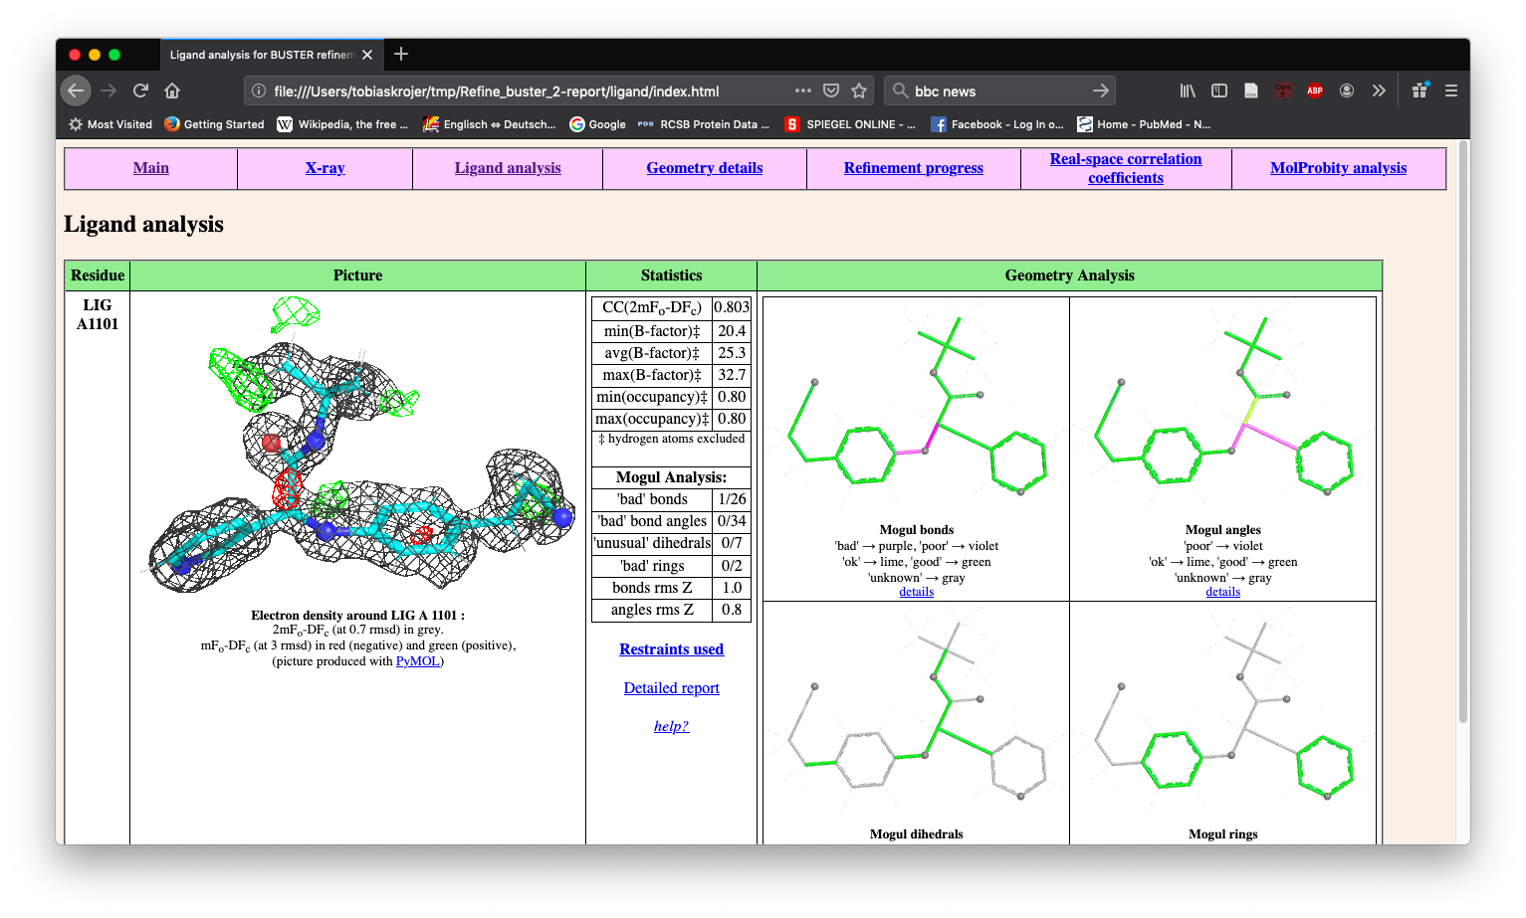
Buster-report runs after every refinement

Slide 38
XCE: routes from MTZ to PDB
Dimple (REFMAC)
Phenix.ligand_pipeline (phenix.refine)
Pipedream (BUSTER)
BUSTER
REFMAC
export
BUSTER
PanDDA
export
giant.quick_refine (REFMAC)

Slide 39
PanDDA group depositions
Questions?

Slide 40
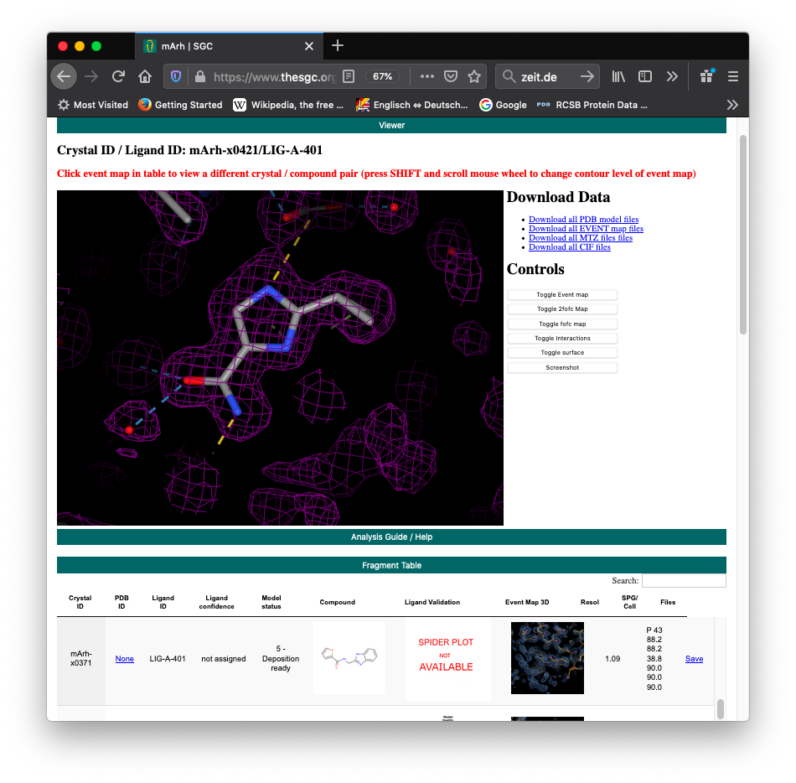
Communicating evidence: HTML summary
Examples: https://www.thesgc.org/fragment-screening
Aditionally: zips all PDB, MTZ, MAP and CIF files

Slide 41
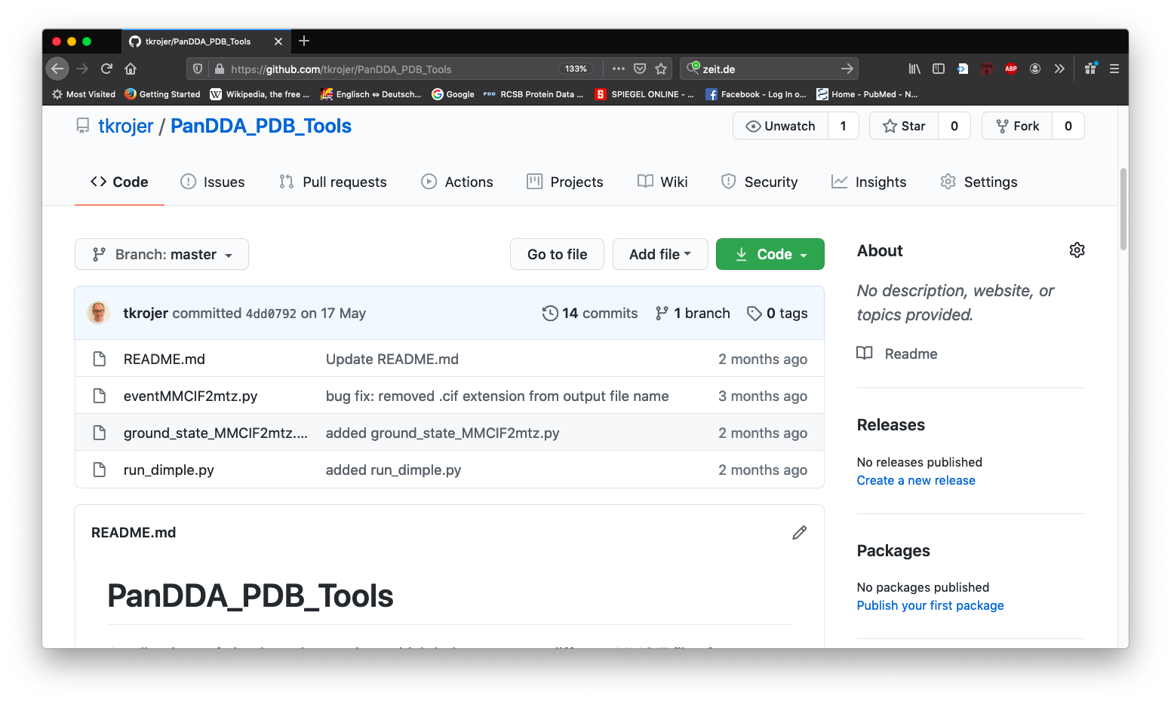
PanDDA_PDB_Tools
https://github.com/tkrojer/PanDDA_PDB_Tools

Slide 42
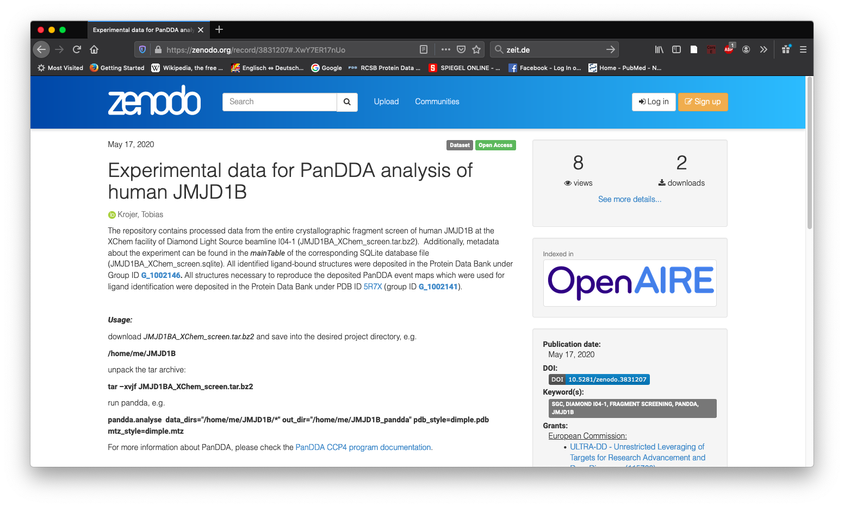
Making additional data available
e.g. ZENODO data repository
Note: link to repository can be added to PDB entries

Slide 43
Future plans
No fundamental changes planned…
v.1.7.0 will be available shortly
Link in to latest Buster-report in Refinement table
XChemReview app
Event maps in Fragalysis
Publish deposition mechanism
In the process of talking to PDBe about group depositions

Slide 44

Contact
Tobias Krojer
tobias.krojer@sgc.ox.ac.uk
www.thesgc.org
FUNDING PARTNERS
The SGC is a registered charity (number 1097737) that receives funds from AbbVie, Bayer Pharma AG, Boehringer Ingelheim, Canada Foundation for Innovation, Eshelman Institute for Innovation, Genome Canada, Innovative Medicines Initiative (EU/EFPIA), Janssen, Merck & Co., Novartis Pharma AG, Ontario Ministry of Economic Development and Innovation, Pfizer, São Paulo Research Foundation-FAPESP, Takeda, and Wellcome Trust
www.thesgc.org

